Slide 1
The more reputable, the more engaged: Exploring customer identification and brand love as mediators and comparing the product to service industries
Laee Choi, Ph.D.
Colorado State University-Pueblo, USA
MiRan Kim, Ph.D.
Michigan State University, USA
He-Boong Kwon, Ph.D.
Colorado State University-Pueblo, USA
6th International Consumer Brand Relationships Conference

Slide 2
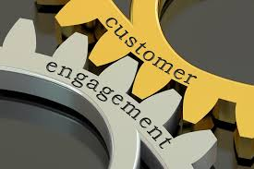
What are Customer Engagement Behaviors (CEBs)?
Conceptualization
Defined as “customer’s behavioral manifestations that have a brand or firm focus, beyond purchase, resulting from motivational drivers” (van Doorn et al. 2010, p. 254).
Should include customer transactions in conceptualization because customers can engage with a firm in profitable ways (Kumar et al. 2010).
Multidimensional construct (Kumar and Pansari 2016)
Customer purchases
Customer referrals
Customer influence
Customer knowledge/feedback
Extant research on antecedents of CEBs has limited to customer-based factors, such as customer satisfaction (Anderson and Mittal 2000; Palmatier et al. 2006), brand commitment (Garbarino and Johnson 1999), and trust (deMatos and Rossi 2008).

Slide 3
Research Questions
R1: Does corporate reputation lead customers to CEBs? (direct effect)
R2: Does customer identification and brand love derived from corporate reputation influence CEBs? (mediation effect)
R3: Are there differences in the impacts of customer identification and brand love on CEBs across the firm types? (moderated mediation effect)
Firm type
(Product vs. Service)
Customer Identification
Brand
Love
Corporate Reputation
CEBs

Slide 4
Stimulus-Organism-Response (S-O-R) Theory
Stimulus
Organism
Response
Environmental stimuli
Emotional States:
Pleasure
Arousal
Dominance
Approach
or
Avoidance
Customer Identification
Corporate Reputation
CEBs
Brand
Love

Slide 5
Hypothesis Development
CI
BL
FT
CR
CEBs
A good corporate reputation can lead to stakeholders’ goodwill toward the company (Fombrun 1996).
Customers’ desire to associate with or belonging to a highly reputed company results in discretionary engagement and/or citizenship behaviors (Gruen 1995; Bartikowski and Walsh 2011).
H1: Corporate reputation has a positive impact on CEBs.

Slide 6
Hypothesis Development
CI
BL
FT
CR
CEBs
Customer identification refers to “the individual's sense of sameness with a particular brand or firm” (Tuškej et al. 2013, p. 53).
Customers tend to identify with a firm based on their perceptions or evaluations of the firm’s characteristics (Dutton et al., 1994) and various attributes, such as products, services, brands, and so on (Underwood et al., 2001).
Customers who identify with a firm are more likely to feel proud of the association, make extra effort to advocate for the firm (i.e., CEBs) (Keh and Xie 2009) and show their extra-role behaviors (Aheame et al. 2005).
H2: The positive relationship between corporate reputation and CEBs is mediated by customer identification with the brand.

Slide 7
Hypothesis Development
CI
BL
FT
CR
CEBs
Brand love is “the degree of passionate emotional attachment a satisfied customer has for a particular trade name” (Carroll and Ahuvia 2006, p. 81).
Customers may view and feel emotional attachment such as brand love to highly reputable brands or firms as attractive due to their superiority (Kim and Lennon 2013; Batra et al. 2012).
Brand love leads customers to perform behaviors that benefit the brand or firm (Batra et al. 2013) and to engage in positive word-or-mouth (Carroll and Ahuvia 2006).
H3: The positive relationship between corporate reputation and CEBs is mediated by brand love.

Slide 8
Hypothesis Development
CI
BL
FT
CR
CEBs
Customer-firm identification leads customers to feel a psychological attachment to the firm (Bhattacharya and Sen 2003).
Carroll and Ahuvia (2006) argue that brand love is a more intense emotional attachment than liking because it contains an integration of the brand into the customer’s identity.
Customer identification with a brand positively influences brand love (Albert and Meruňka 2013).
H4: Customer identification has a positive impact on brand love.

Slide 9
Hypothesis Development
FT
CI
BL
CR
CEBs
The effect of emotional responses on customer behaviors or contributions may be evident across all industries, but the magnitude of the effect varies (Pansari and Kumar 2017).
Due to lack of tangibility in the service industry, customers may rely more on intangible sources to evaluate the firms and determine their future behaviors toward them (Jackson et al. 1995).
The services are more likely to benefit from customer identification than the product firms because customers rely more on company attributes in contexts of low differentiation among the offerings, i.e., the service industry (Bhattacharya and Sen 2003).
H5a: A firm type moderates the relationship between customer identification and CEBs, such that the effect of customer identification on CEBs is stronger for the service industry than for the product industry.
H5b: A firm type moderates the relationship between brand love and CEBs, such that the effect of brand love on CEBs is stronger for the service industry than for the product industry.

Slide 10
Research Method
Data collection: Web-based online survey via snowball sampling
Sample size and profiles: a total of 152 U.S. customers
Female (64%), 20 – 30 years old (76.8%), Caucasian (64.2%), $89,999 and below (57.6%)
Measurement
10 retail firms (5 product and 5 service retailers) from the Fortune 500 companies
Corporate Reputation: Customer-based corporate reputation (CBR) scale (Walsh et al. 2009)
Customer orientation (3 items), Good employer (3 items), Product and service quality (3 items), Reliable and financially strong company (3 items), social and environmental responsibility (3 items)
Customer Identification: 3 items (Tuškej et al. 2013)
Brand Love: 10 items (Carroll and Ahuvia 2006)
CEBs: Kumar and Pansari (2016)
Purchase (3 items), Referrals (4 items), Influence (3 items), Knowledge/Feedback (3 items)

Slide 11
Data Analysis and Results
Measurement model testing
CFA (AMOS 22) confirmed validity and reliability
Model fit: Χ²₍₄₇₁₎=764.35, p<.000, CFI=.94, TLI=.93, IFI=.94, RMSEA=.06_{(.056~.072)}
Hypotheses testing
Mediation effect testing (PROCESS Model 6; Hayes 2013)
If the 95% CI does not contain zero, the significant impact is confirmed.
Path | β | SE | CI [Lower, Upper] | Hypothesis
Direct effect
Corporate Reputation → CEBs | .36 | .11 | [.14, .57] | H1: Supported
Customer Identification → Brand Love | .56 | .06 | [.44, .69] | H4: Supported
Indirect effect
Corporate Reputation → Customer Identification → CEBs | .25 | .10 | [.08, .45] | H2: Supported
Corporate Reputation → Brand Love → CEBs | .15 | .07 | [.03, .31] | H3: Supported
Corporate Reputation → Customer Identification → Brand Love → CEBs | .11 | .05 | [.02, .22]
Note: SE=standardized error; bootstrapping based on N=5000 subsamples; 95% biased-corrected confidence intervals (CI).

Slide 12
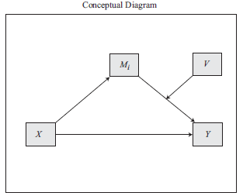
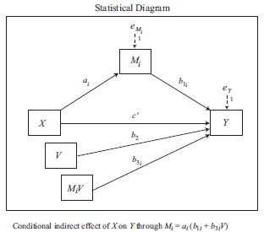
Data Analysis and Results
Hypotheses testing (continued)
Moderated mediation effect testing (PROCESS Model 14; Hayes 2013)
Path | a | b₁ | b₃ | c’ | Moderator (V) | a(b₁+b₃V) | CI [Lower, Upper]
Corporate Reputation → Customer Identification → CEBs | .76*** | .48*** | .04 | .50*** | Product Service | .35*** .38*** | [-.16, .20] H5a: Rejected
Corporate Reputation → Brand Love → CEBs | 1.00*** | .46*** | -.14 | .42** | Product Service | .54*** .40*** | [-.38, .10] H5b: Rejected
Note: Bootstrapping based on N=5000 subsamples; 95% biased-corrected confidence intervals (CI). ** p<.01; *** p<.001

Slide 13
Post-hoc Analysis
CR
CO
GE
P&SQ
R&FSC
S&ER
CEBs
Dominance analysis
To evaluate the importance of each critical predictor relative to other predictor (Budescu 1993).

Slide 14
Implications
Theoretical implications
Exploring a firm-based antecedent, corporate reputation, of CEBs.
Drawing on S-O-R theory, empirically testing the role of customer-based factors, customer identification and brand love, as mediators.
Attempting to investigate the difference in the corporate reputation-customer identification-brand love-CEBs relationship between product and service industry.
Managerial implications
Understanding importance of CEBs as sustainable competitive advantages and corporate reputation as a crucial source that leads to CEBs.
Being aware of the role of customer identification and brand love to link corporate reputation to CEBs.

Slide 15
Limitations and Future Research
Limited the generalizability due to snowball sampling.
Need to collect larger samples and more diverse demographic profiles.
Used 10 retailers from Fortune 500.
Improve generalizability with more firms.
Focused on customer identification and brand love as mediators.
Consider other customer-based factors (e.g., satisfaction, trust, loyalty).
Other than corporate reputation, consider firm-based factors such as firm size/diversification and brand characteristics.
Need to extend dominance analysis with concrete hypotheses based on underlying theories.

Slide 17
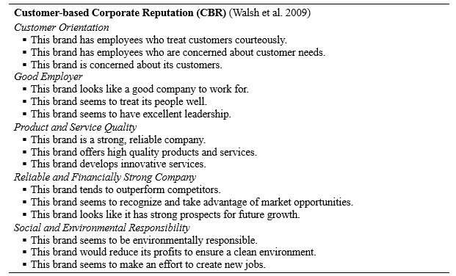

Slide 19
